Slide 1
Building a chess game with HTML, CSS, and JavaScript
Notes:
Hi everybody, I’m Jack and I’m presenting about my sprint on a web chess game. I will briefly cover other aspects of the game and then I will go into more detail about my sprint, which focuses on moving an image between cells.

Slide 2
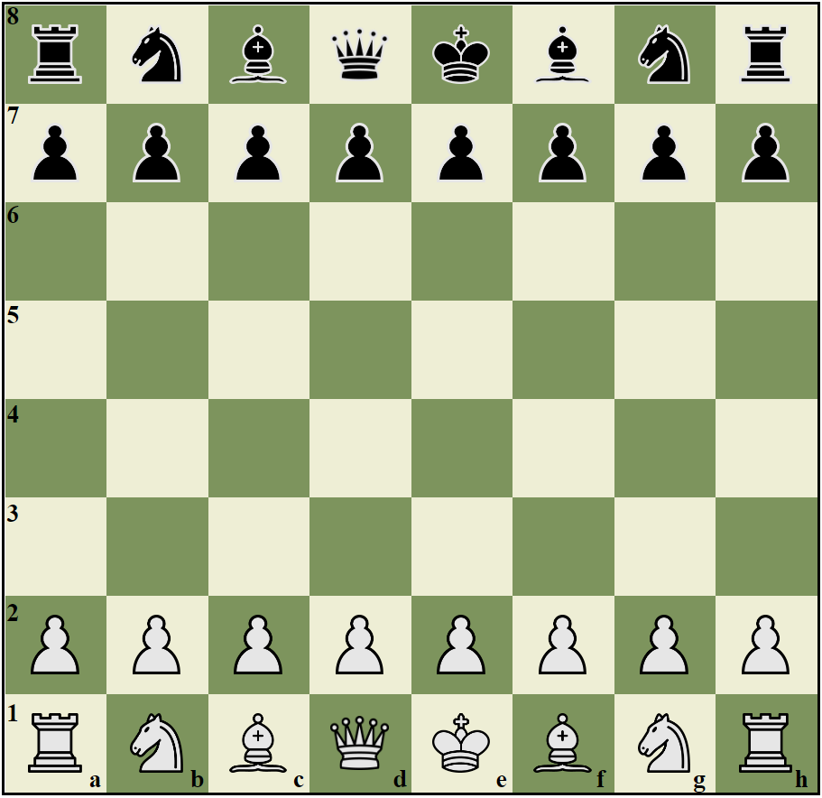
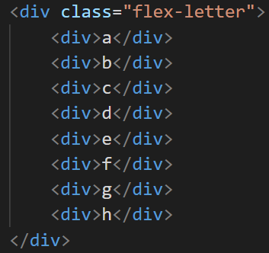
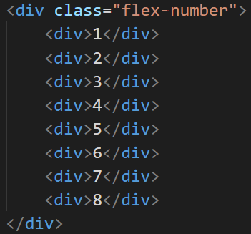
Creating table and labels
Create 8x8 table using the <table> tag
Add row and column attributes to each td (cell)
Add image div inside the cells to contain the image
Create labels by storing each element in a container
Notes:
First I created an 8x8 table with the <table> tag. Next, I added row and column attributes for each cell, I also added img divs inside each cell. Finally, I created two separate div-containers for the number and letter labels with each element being in its own div.

Slide 3
Styling the table and labels
Move the table and labels to the center of the browser
Add border for table
Change the item spacing in the labels to match the table width and length
Notes:
Next I apply CSS to the raw table and labels to move them to the center of the browser, color each cell based on the row and column being odd or even, and add border for the table. I used flexbox for the labels because you can change the spacing between elements.

Slide 4
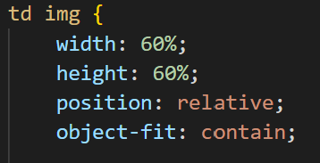
Adding images into cells
Add the image to the div inside of the cell
Set the image to fit inside of the cell by setting the its position relative to the cell and setting the cell to contain the image
Notes:
You can add an image inside the cells by changing its src attribute. Object-fit: contain makes it so that the resized image keeps its original ratio.

Slide 5
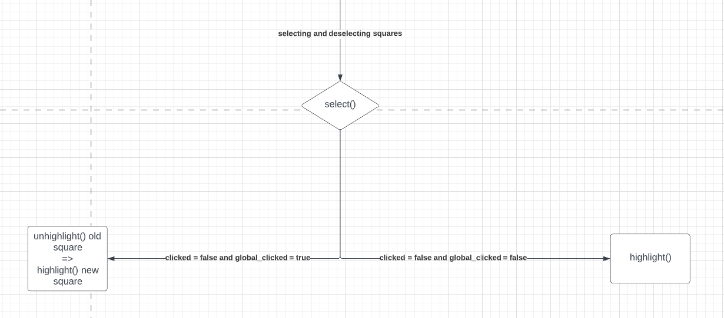
Selecting and deselecting cells
Select() to decide if it should highlight or unhighlight the clicked cell based on clicked
Highlight() highlights the cell
Unhighlight() unhighlights the cell
Notes:
On the very first click, we will always highlight the square. If you are clicking on another square after clicking the first one, the code will run unhighlight() then run highlight() on the new square. Another situation is when you double click on the same square. In that case, we only run unhighlight().

Slide 6
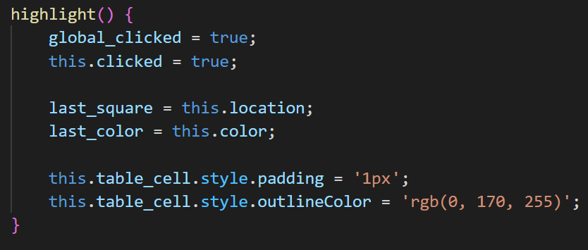

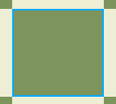
Highlighting cells
Unhighlighted cell
Highlighted cell
Highlight function
Set last_square to currentCell so unhighlight() can unhighlight this cell once another one is clicked
Notes:
This is an unhighlighted cell and this is a highlighted cell. This is the highlight() function.

Slide 7
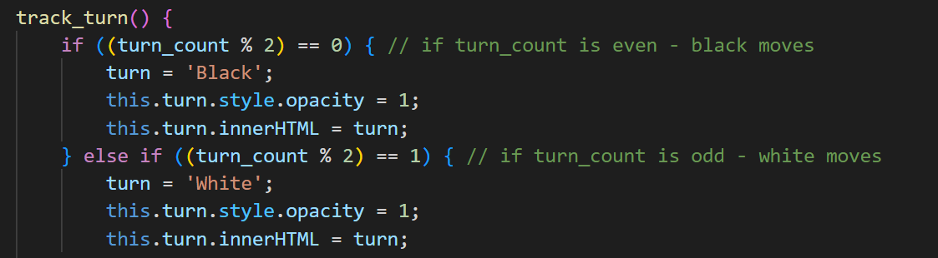
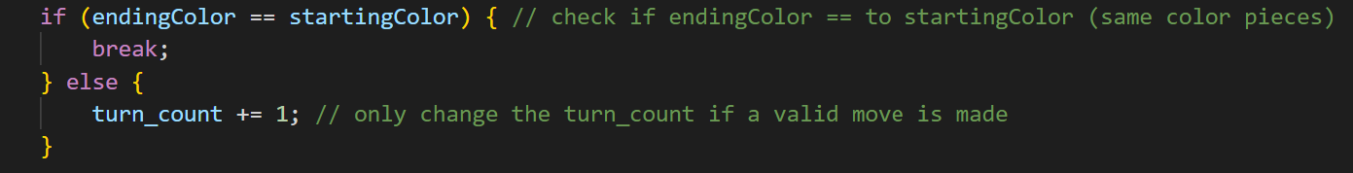

Tracking player turn
Use a turn counter that it incremented every time a valid move is made
Starting side is white
Notes:
Here it starts to shift towards my sprint a bit more. At first, turn_count would increase every click, but when you’re moving a piece, you need 2 clicks. So I changed it to only change turn_count every time an image was moved aka a valid move was made.

Slide 8
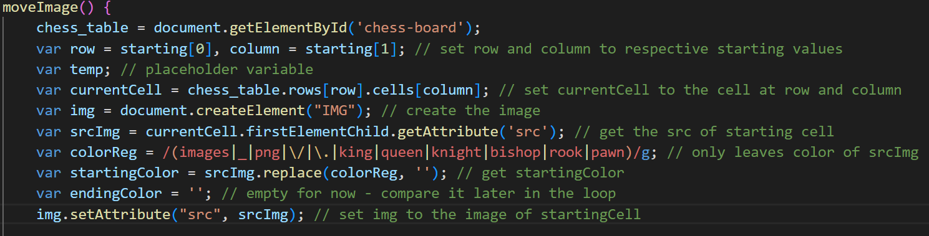
Setting up the variables
Set currentCell to the row and column attribute saved in starting[]
Get srcImg of currentCell and implement colorReg to get startingColor and endingColor
Determine if 2 pieces are the same color
If it is, prevent them from capturing each other
Save the image of currentCell to img variable
Notes:
moveImage() is the main focus of my sprint. There are also two arrays called starting and destination which are used to save the row and column of each click.

Slide 9
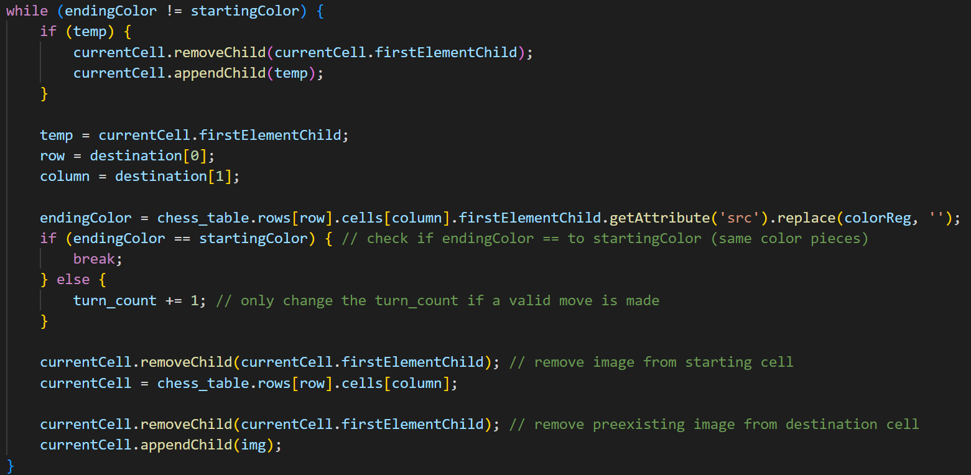
Moving the image between cells
Saved image (firstChild) of startingCell to img
Update currentCell to destinationCell
Check if startingColor is the same as endingColor
Notes:
First we set temp to the image on startingCell, then we determine if endingColor matches startingColor, if it does, break the loop and don’t move the image. Else we increase the turn_count and continue. We then remove image on startingCell, set currentCell to destinationCell, remove preexisting image from destinationCell, and add the img to destinationCell.

Slide 10
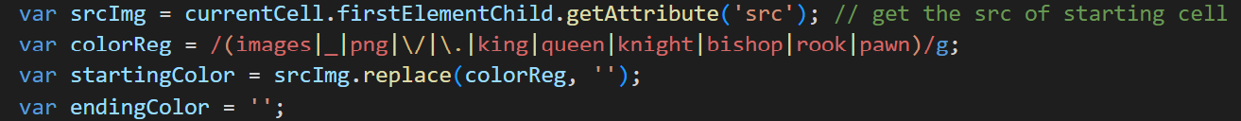
Applying regex to srcImg
“.replace” replaces the terms that matches colorReg with “”
colorReg removes everything but the color in the srcImg
(abc) capture group abc
\. \* \\ escaped special characters
a|b match a or b
(a|bcd|\.) match a, bcd, and “ . ”
Notes:
Here you can see that the terms are in parenthesis which captures a group, the vertical dash means a or b, the backwards slash allows us to capture special characters. “.replace” replaces the terms that matches colorReg with a blank, deleting it. This leaves only the color of the image at the selected cell.

Slide 11
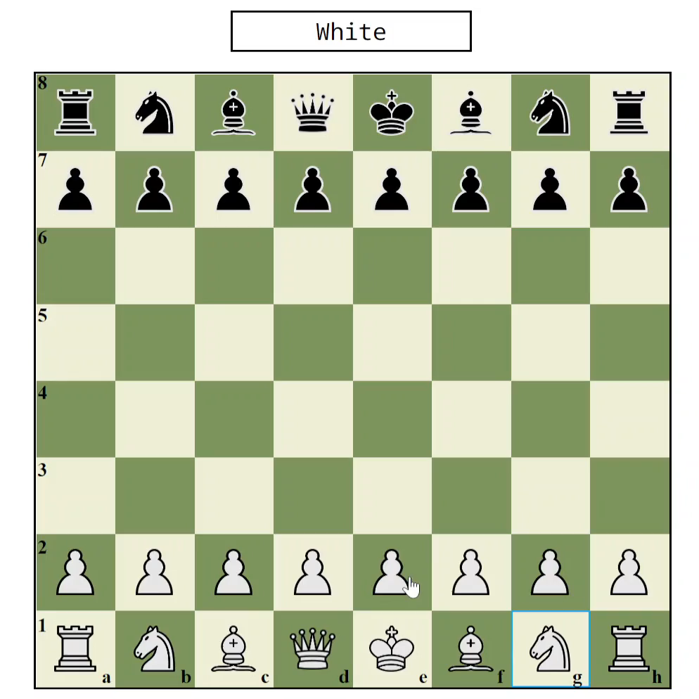
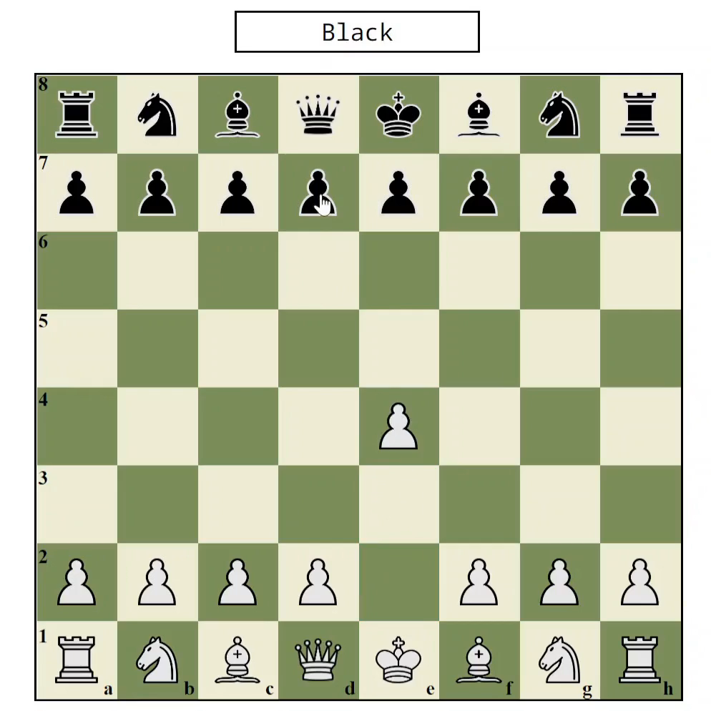
Deciding a move’ legibility based on cell color
Situation 1: same-colored pieces
Situation 2: different-colored pieces
Notes:
Situation 1: we can see that I’m selecting the knight and I tried to capture my own pawn which doesn’t work, we can also see that the turn did not change because technically no move was made.
Situation 2: the white pawn is able to take the black pawn because they are different colors, the turn also changed because this is a valid move.

Slide 12
Roadmap
Work on implementing piece logic over the break
Add a timer for each side (optional)

Slide 13
Thank you for listening.
Notes:
I appreciate your attention today and I hoped my project was somewhat interesting.

